Slide 1

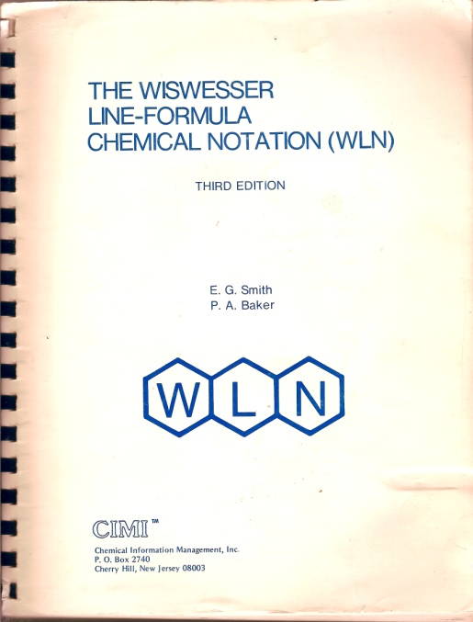
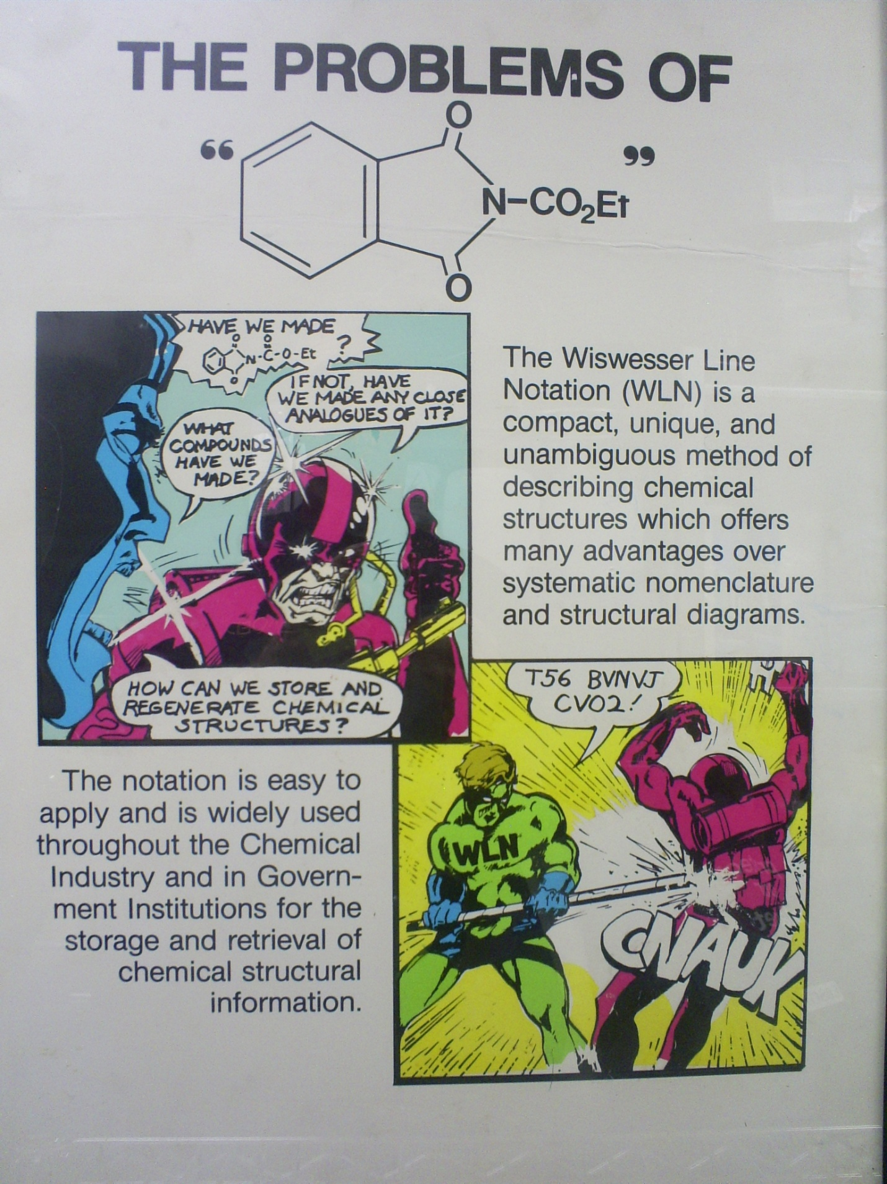
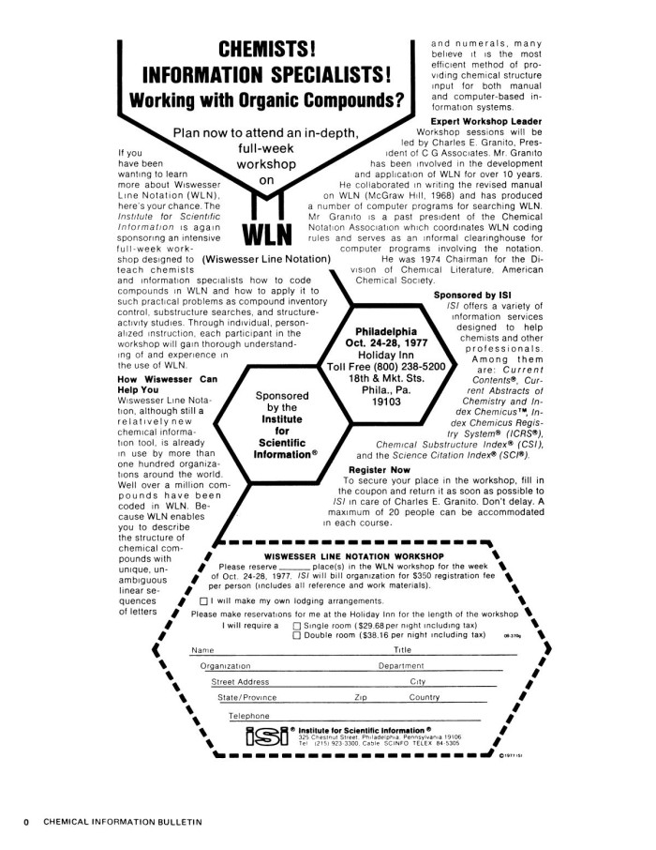
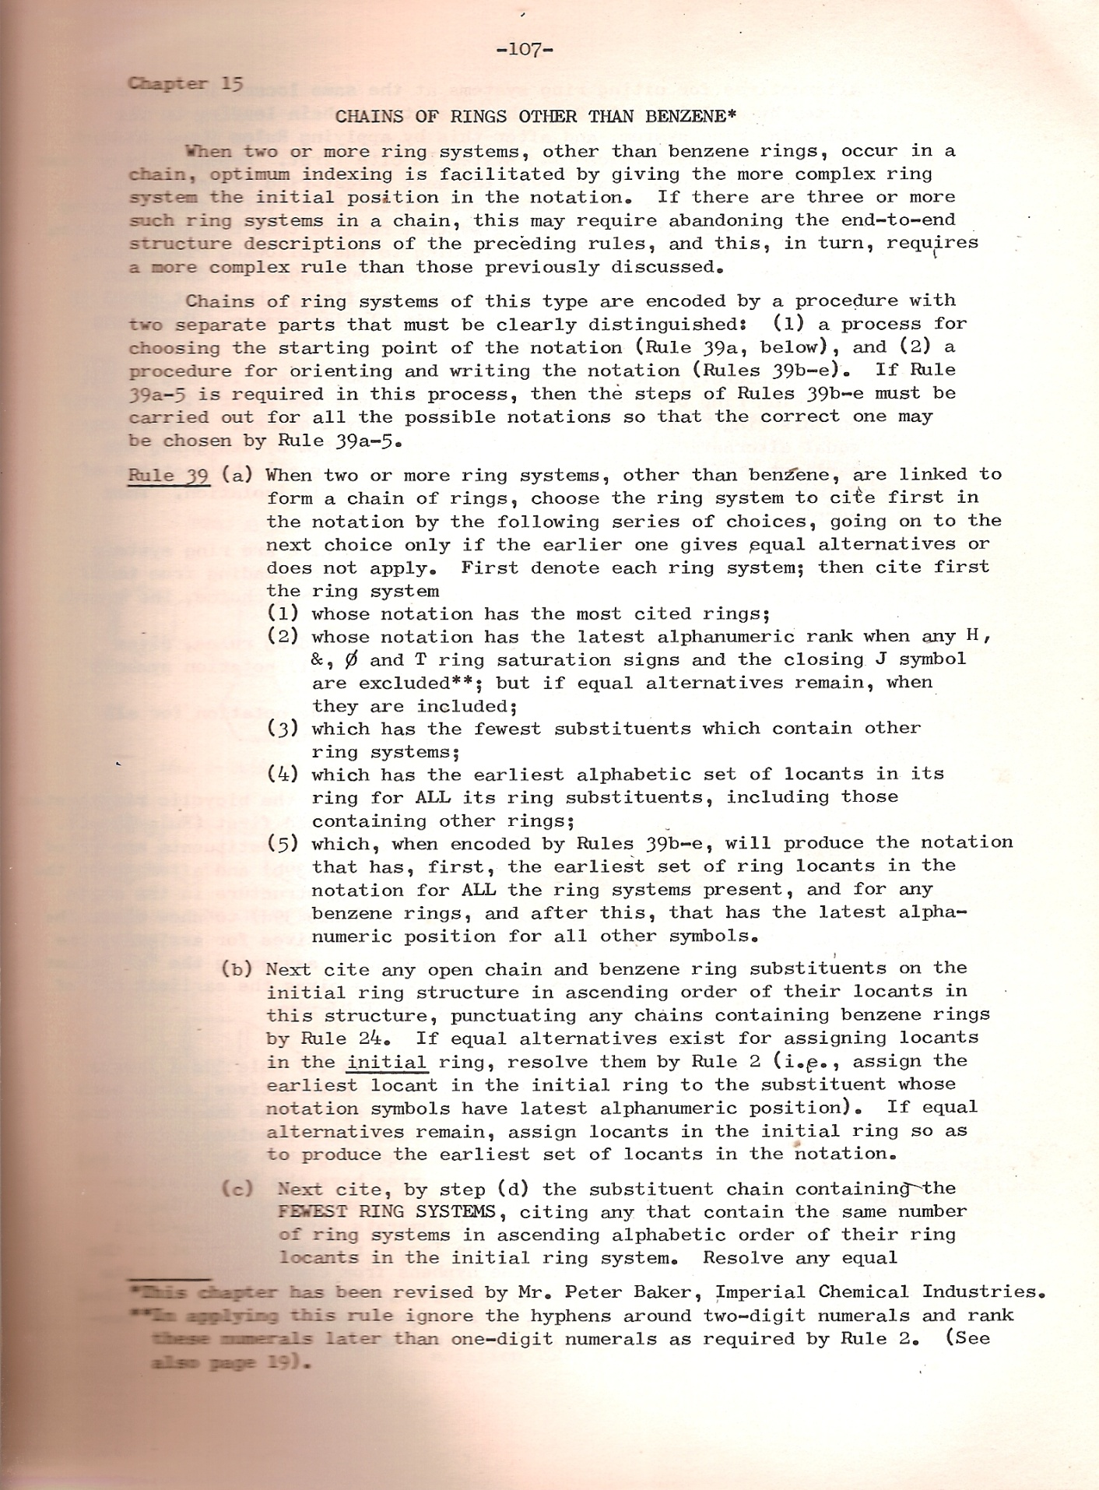
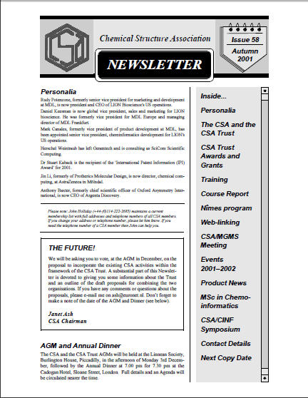
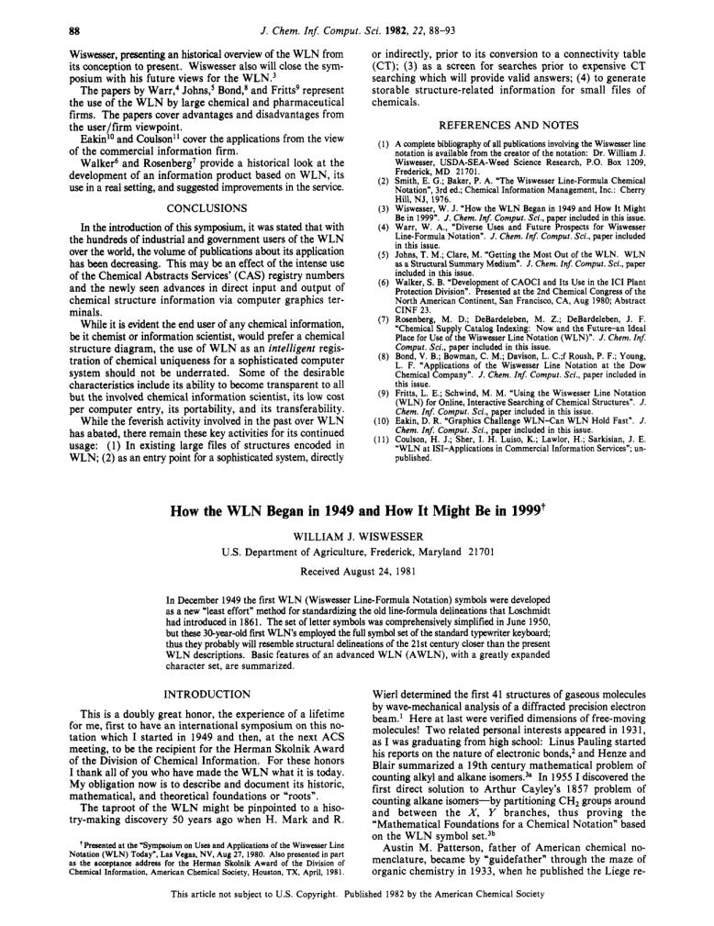
A History of the Chemical Structure Association Trust
From the notations of the 60s to the present
Bonnie Lawlor, Phil McHale and CSA Trustees
Background
The Chemical Structure Association Trust (CSA Trust) is a charitable institution which promotes education, research and development in the field of storage, processing and retrieval of information about chemical structures, reactions and compounds. The CSA Trust was founded in December 1988, but was preceded by other organizations which were dedicated to furthering the study of representations of molecules and reactions as a way of adapting to the then-emerging computer-based technologies. This poster presents a history of these organizations from the 1960s onwards against the backdrop of evolving methods for handling chemical structures in computers.
Chemical Notation Association
When quinoline was T66 BNJ – life before graphics
W(h)ither WLN?
Quinoline is and that’s all we need
The Chemical Notation Association (CNA) was established in the USA in 1965 when notations such as the Dyson Notation and the Wiswesser Line Notation (WLN) were emerging as methods to document chemical structures in a form that could be easily manipulated by computers. Each of the methods attempted to encode chemical structure information for computer storage and searching and to provide an “easily understood” presentation in lieu of a full structure diagram. Remember – this was before computers could display graphics, so these systems relied on the ASCII character set. And the “easy understanding” was limited to the cognoscenti who understood the rules of the notation: very few practicing chemists had the time or inclination to learn them, so all structure input and searching had to be done by an intermediary information scientist. Nevertheless, these notation systems were of particular interest to pharmaceutical and agrochemical industries to document their growing inventories of research chemicals. The CNA was active in educational activities to train users of WLN and to monitor rule changes.
The CNA was also involved in the organization of the NATO/CNA Advanced Study Institute on Computer Representation and Manipulation of Chemical Information, held in Noordwijkerhout in June 1973, which was the predecessor to the successful series of International Conferences on Chemical Structures (ICCS) which have been held at the same venue every three years since 1987.
In July 1981, members of the CNA (UK) were asked if there should be an organization created which would represent ALL who were interested in chemical structure and data handling and not restricted to Notations.
The answer was “yes”, and a new organization, the Chemical Structure Association (CSA), was created, with the CNA (UK) as a WLN sub-group for those still involved with WLN. The CSA was inaugurated on 6th September 1982 at the University of Exeter, UK, when the Executive Committee of the CNA (UK) became the first Executive Committee of the CSA. This meeting was also an Extraordinary General Meeting of the CNA (UK) and it agreed that if the CNA (UK) were wound up, its funds would pass to the CSA. The CNA (UK) was wound up in December 1983. Dues continued to be paid to the CNA parent body from the WLN sub-group of the CSA.
The CSA promoted educational activities and enjoyed an international membership many of whom had been members of CNA (UK). The CSA was guided by many of the active participants of the CNA.
The CSA became a very active international organization and it was involved in organizing conferences and meetings as well as continuing with the Newsletter.
CAN(UK) Poster from 1970s
WLN Workshop October 1977
WLN Rule39 – Chains of Rings
CSA Newsletter from 2001
Chemical Notation Association (UK)
Enter the Brits….
The CSA Trust is born
The success of CSA conferences, courses and seminars lead to a surplus of CSA funds, and it was suggested that it would be beneficial to set up a UK registered charity, so that the funds could be used for charitable purposes, e.g. for awards and grants, rather than incurring excessive Corporation Tax. Following extensive discussions with the UK Charities Commission, the Declaration of Trust was made on December 5, 1988, signed by Bill Town, Janet Ash, Geoffery Downs, Frances Finn, Ian J. Tarr, and L. Arthur McArdle, and the CSA Trust was declared a UK Registered Charity No: 328042.
The CSA and the CSA Trust continued to successfully operate alongside each other. In the 1990s, following a reduction in membership of the CSA, the Executive Committee considered the possibility of merging with other organizations, such as the MGMS and the RSC-CIG, but neither of these organizations was considered suitable. The difficulty of finding people to run the CSA, in addition to finding Trustees to put the work into running the CSA Trust, led to the proposal at both AGMs in 2001 that the two organizations should merge, and the Trust could then take on the role of conference organization and Newsletter production, in addition to allocating funds for grants and bursaries. After several communications with the Charity Commission the merger was successfully achieved in 2001 and the CSA formally closed, transferring all its funds to the CSA Trust.
New Committees were set up by the Trust to promote the work of the Trust and oversee the work formerly carried out by the CSA, including: Public Relations (Newsletter, Website, Membership Relations); Meetings and Training; Fundraising; Budgets and Finance; Grants; and CSA Trust Mike Lynch Award. These activities carry on today, managed and overseen by a Board of some 25 Trustees drawn from academic, government and commercial organizations in countries around the world. Since 1989 the Trust had awarded over £25,000 in bursaries and grants to support travel and research work. For more details see the CSA Trust web site at www.csa-trust.org.
The Trust also continues the CSA tradition of an Annual Dinner following the Annual General Meeting (AGM) on the Monday prior to the opening of the London Online Information Meeting at Olympia.
The UK Chapter of the CNA held its Inaugural Meeting on November 11, 1969 at Fisons Pharmaceuticals in Loughborough. The list of other participants in CNA(UK) provides a nostalgic glimpse into the pre-merger landscape of UK-based biopharma and agrochemical industry in the late 60s and 70s: Allen & Hanburys, Beecham, Boots, Glaxo, ICI, Pfizer, Smith Kline & French, Wellcome. While the parent CNA in the USA was active in training users of WLN and monitoring rule changes, CNA(UK) encompassed a wider interest of industries in the USA and Europe. The CNA (UK) was also assigned the rights to the Dyson Notation in 1980, following the death of G. M. Dyson. Among the early participants was Ernie Hyde of ICI Pharmaceuticals who dedicated much effort to the organization and after whom the CSA Trust meritorious service award is named. There had been discussions in 1975 about the possibility of setting up a Chemical Notation Association Trust in the UK, but this never came to fruition.
CNA(UK) continued to offer WLN Tutorials on the rules and applications of WLN, usually in two-to-three day residential courses at one of the UK’s newer universities, and long serving tutors included Peter Baker, Barrie Walker, Wendy Warr and Phil McHale. In addition to tutorials, CNA(UK) also organized a series of conferences in the area that we now call cheminformatics, covering topics ranging from substructure searching and design of information systems, through to integrated databases and searching the chemical literature and patents. These conferences often brought together leading proponents and experts in the various areas, and the content was sufficiently valuable that the proceedings were written up and published.
One other CNA(UK) publication of note is the CNA(UK) Newsletter, first published in 1974, and still going (as the CSA Trust Newsletter). Back in the 70s, before Twitter, Facebook, Google, Yahoo, etc. when even email was in its infancy, the CNA(UK) membership wanted a way to be kept informed, share experiences, make announcements, etc. so a newsletter was created, typed up, photocopied and mailed to members. There have been a number of editors, with the longest serving being Frances Daniels (40 issues, 1994-2008) and Phil McHale (37 issues, 1979-1989).
Structure Handling Evolves
Now quinoline is and we can do more with it…
Chairpersons of the CNA(UK), CSA, and CSA Trust
CNA(UK) | 1969 – 1975 | Ernie Hyde
CNA(UK) | 1975 – 1978 | Tony Faulkner
CNA(UK) | 1978 – 1981 | Sandra Ward
CNA(UK) | 1981 – 1982 | Mike Allen
CSA (WLN sub-group) | 1982 - 1986 | Peter Baker
CSA | 1984 – 1993 | Peter Nichols
CSA | 1993 – 1995 | Diana Leitch
CSA | 1996 – 2001 | Janet Ash
CSA | 2001 – 2002 | Peter Nichols
CSA Trust | 1988 – 2000 | Bill Town
CSA Trust | 2000 – 2005 | Guenter Grethe
CSA Trust | 2005 – current | Andreas Barth
Technology continued to evolve, and two major advances expanded the utility and accessibility of chemical information. First, programs were written to convert WLNs to computer-manageable connection tables, which were then amenable to structure and substructure searching. A number of in-house systems were developed, and one which gained some traction was CROSSBOW (computerized retrieval of structures based on WLN) developed at ICI Pharmaceuticals. The second advance was the availability of affordable graphics terminals coupled with software to convert between graphical representations of compounds and their connection tables. An early commercial package which did this was MACCS from the erstwhile Molecular Design Ltd.
These advances opened up corporate and public chemical registry and inventory files – which had previously only been accessible by information scientists – to so called “end user” chemists who could now draw and register compounds and create and run their own structure and substructure searches. The availability of connection tables also made it possible to do more with structures and tools rapidly appeared to run similarity searches, generate and search 3D structures, calculate properties, generate names, map reactions, and exchange structure files with collaborators and other structure-handling systems. And all these advances diminished the need for chemical notations like WLN, and interest in them waned.

